Slide 1
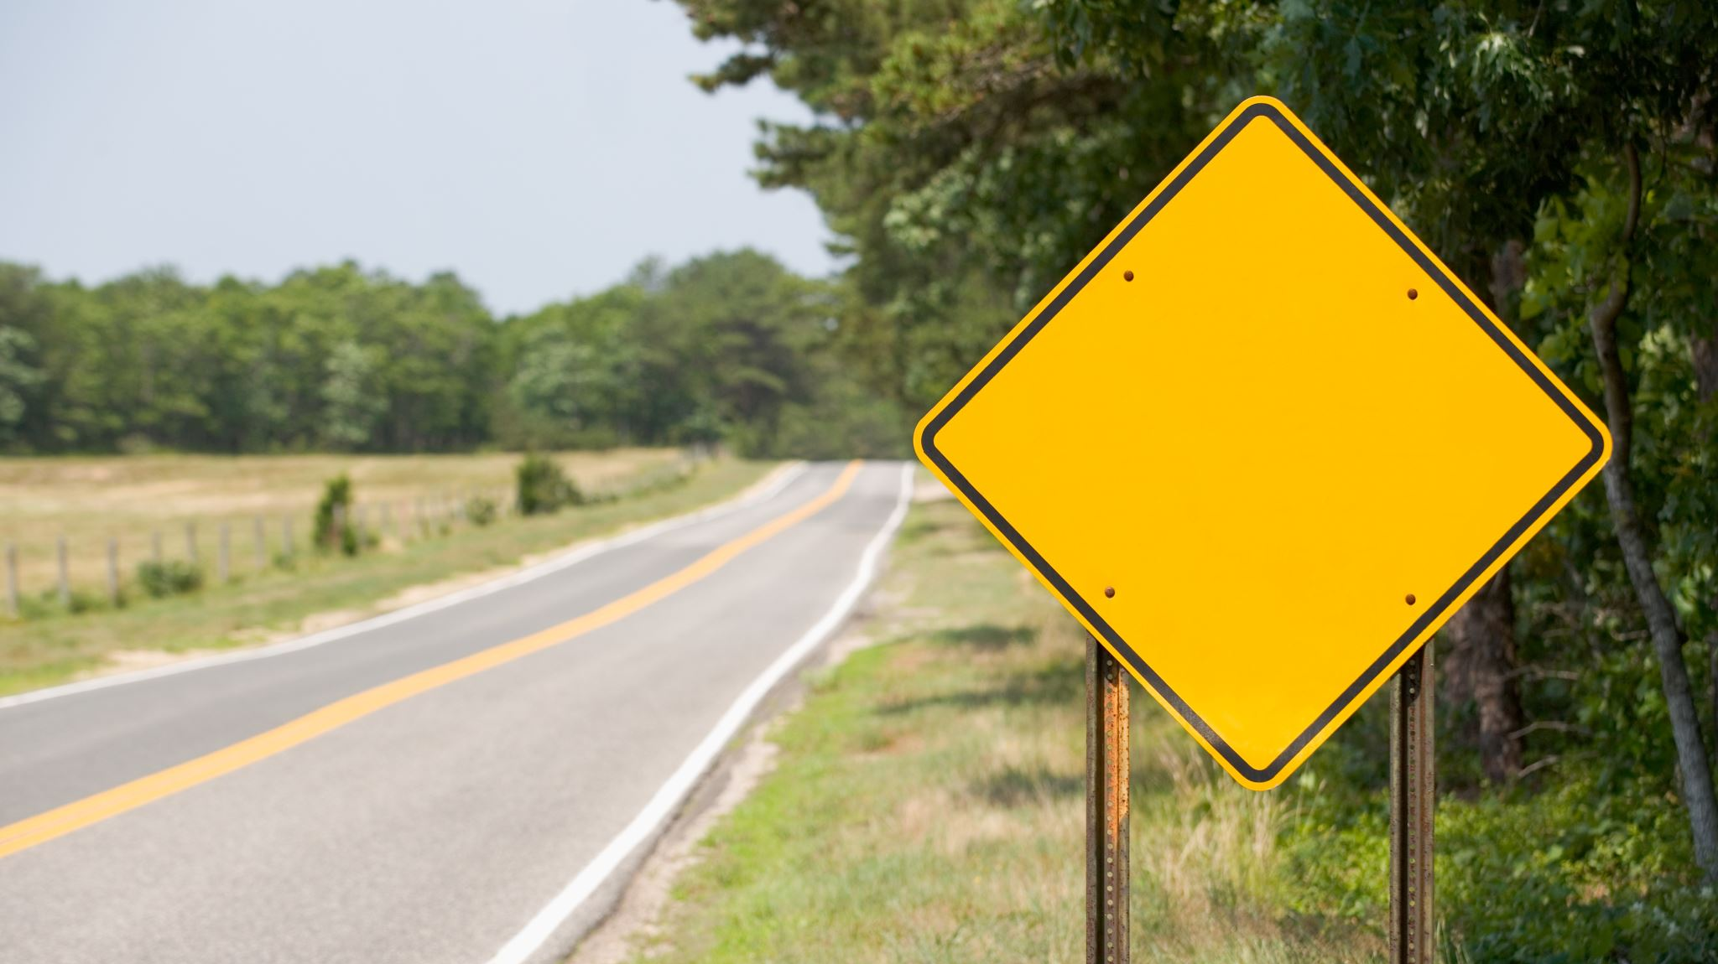
ROAD SIGN DETECTION USING MACHINE LEARNING
BY
Jaylen Guevara-Kirksey Bey
Austin French
Thomas Haight
Asif Mahmud

Slide 2








INDEX
INTRODUCTION
PROJECT OVERVIEW
KEY PREPROCESSING STEPS
Challenges and Roadblocks
FUTURE SCOPE
SUMMARY
Demo
Q&A

Slide 3



INTRODUCTION
This is our final project for the course.
We wanted to showcase our competency in AI & Machine Learning.
The project has real-world applicability and can be scaled for production.

Slide 4
KEY PREPROCESSING STEPS:
We followed a structured pipeline to ensure high-quality, clean, and well-prepared data before training our machine learning model. Here’s how we prepared our dataset:
Step 1: Data Acquisition
Step 2: Data Cleaning
Step 3: Data Processing
Step 4: Data Transformation & Optimization
Step 5: Data Storage & Efficient Access

Slide 5

STEP 1: DATA ACQUISITION
We downloaded the Road Sign Detection dataset from Kaggle.
The dataset contained 877 images with corresponding XML annotation files in PASCAL VOC format.
We parsed the annotation files using xml.etree. ElementTree to extract road sign labels.
Notes:
Data Acquisition: Kaggle dataset, KaggleHub to download files, XML ElementTree library to get the labels, OpenCV to read in images.

Slide 6
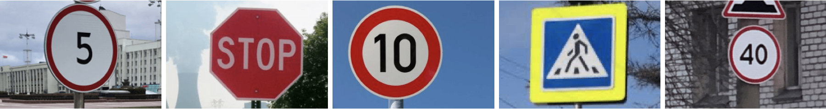
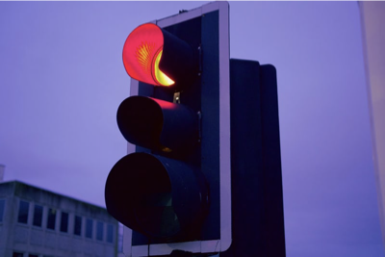
Classes
Speed Limit Stop Sign Crosswalk Traffic Light

Slide 7


STEP 2: DATA CLEANING
Removed faulty images with more than one type of traffic sign (ex. traffic light and crosswalk).
Resampled speed limit images to balance the data and avoid data leakage.
Shuffled the images to further prevent data leakage.
Notes:
Data Cleaning: Removing images from the dataset that had multiple types of traffic signs in the image (ex. traffic light & stop sign), c, & shuffle

Slide 8



STEP 3: DATA PREPROCESSING
Re-sized all images to the same height/width.
Normalized the pixel values to be between 0 and 1.
Encoded and reshaped the traffic sign labels.
Notes:
Image Processing: Resizing, Normalizing pixel values, Encode labels

Slide 9
STEP 4: DATA TRANSFORMATION & OPTIMIZATION
Image augmentations
to increase
training
set.
# of layers:
Conv2D,Batch
Normalization,
Flatten
Dropout,
etc.
Layer shapes &
activation functions
Batch size, epochs, learning rate

Slide 10


STEP 5: DATA STORAGE & EFFICIENT ACCESS
To speed up data retrieval during model training, we serialized and saved the preprocessed images and labels using Pickle (.pkl files).
The models were stored as .keras files to keep track of the development and for later use.
Notes:
Pickle images: This ensured that we did not have to reload and process images every time the model was trained.

Slide 11
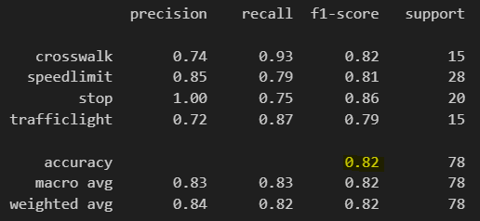
Classification Report

Slide 12
Challenges & Roadblocks
-Images with more than one traffic sign in it
-Unbalanced images (mostly speed limit)
-Optimization efforts leading to lower accuracies
-Time to train the models

Slide 13




SUMMARY
IMPLEMENTED ROAD SIGN DETECTION USING MACHINE LEARNING.
FOCUSED ON ROBUST DATA PREPROCESSING FOR MODEL TRAINING.
ENSURED DATASET INTEGRITY THROUGH STRUCTURED DATA STORAGE.
THE PROJECT SHOWCASES OUR CAPABILITY TO HANDLE REAL-WORLD AI TASKS.

Slide 14
Demo
https://d3820cd90bc3a1e00d.gradio.live/

Slide 15




FUTURE SCOPE
Enhancing the Model:
Real-Time Deployment:
Scaling Up:
Integration with IoT:
Implement YOLOv5 or EfficientDet for better object detection accuracy.
Integrate with autonomous vehicles or driver-assist systems.
Humanoid robots that can assist the blind and elderly.
Train on larger datasets with more road sign categories, and the ability to classify more than one sign at a time.
Deploy on edge devices (e.g., Raspberry Pi, NVIDIA Jetson) for on-road detection.

Slide 16

Q&A
Feel free to ask any questions!

